Slide 1
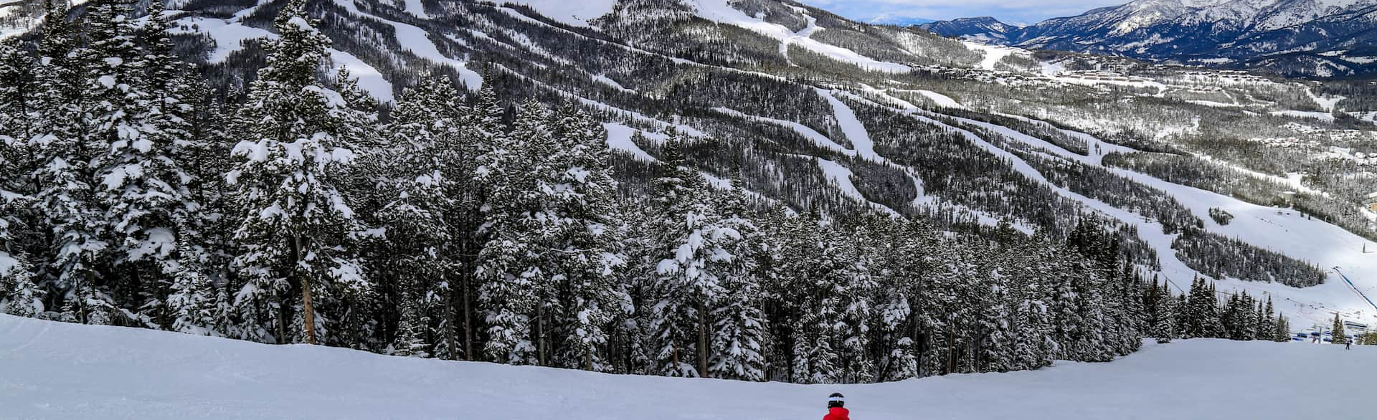
Big Mountain Resort
By Data Science Team

Slide 2
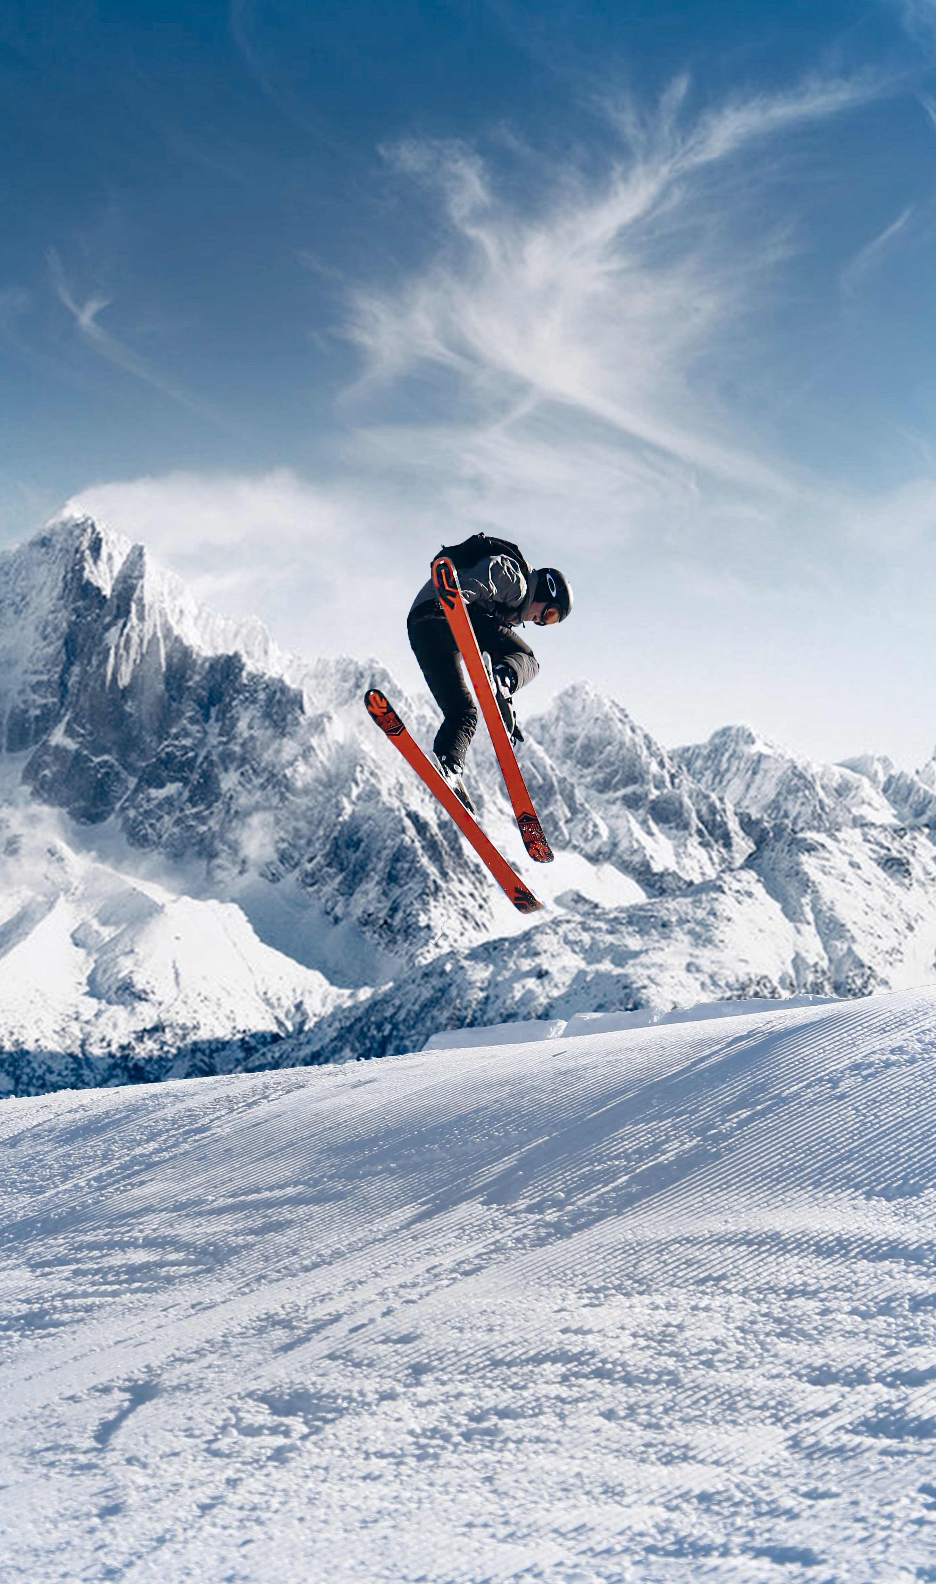
Problem identification
How can Big Mountain Resort select a better value for their ticket price by Nov 1, 2024, while also considering changes that will cut costs without undermining ticket price by 10% or supporting an even higher ticket price?

Slide 3
Criteria for success
The criteria that will deem this project successful is to select a better value for their ticket price by Nov 1, 2024, while also considering changes that will either cut costs without undermining the ticket price by 10% or support an even higher ticket price.
Scope of solution space
The Data Science Team's specific focus is to implement a more data-driven business strategy to select a better value for the ticket price while considering changes that will cut costs.
Constraints within solution space
These were some of the constraints that may have prevented this business initiative from succeeding
Additional chair increases in their operating costs by $1,540,000 this season.
Getting specific user-level access granted to an SQL database or an S3 bucket.

Slide 4
Recommendation and key findings
Considering the listed factors, it seems reasonable to suggest increasing the ticket price to $97.96, given the current price of $81, indicating room for an increase.
The substantial difference between our resort's actual price and the predicted price implies that Big Mountain Resort might be undercharging.
Conversely, adding a run, increasing the vertical drop by 150 feet, and installing an additional chair lift would raise the ticket price by $2.22.
Over the season, this price increase would amount to $3,888,889. Interestingly, adding 2 acres of snow making shows no discernible impact.
Also, the finding suggests that closing one run has no impact, but closing 2 and 3 consecutively reduces support for ticket price and revenue. If Big Mountain were to close down 3 runs, it might be as effective as closing down 4 or 5, with no further loss in ticket price.
However, increasing closures to 6 or more results in a significant drop.

Slide 5
Exploratory Data Analysis
Principal Components Analysis (PCA) was also performed, and the step involved identifying correlations, with a specific focus on the target feature.
Concerning numerical and categorical features, a robust positive correlation was observed between 'vertical_drop' and ticket price. The target feature, AdultWeekend ticket price, showed reasonable correlations, particularly with 'Runs' and 'Snow Making_ac.’
A key observation regarding state and prices is the absence of an obvious pattern.
Consequently, the decision was made to treat all states equally and work towards building a pricing model that considers all states together without treating any state as particularly special.

Slide 6
Pre-processing and Training Data
To initiate pre-processing, we conduct a Train/Test Split, dividing the data into training and testing sets to independently assess model performance.
We use Metrics to evaluate the agreement between different sets of values.
One such metric is the coefficient of determination (R-squared), indicating the proportion of variance in the dependent variable (ticket price) predicted by our model.
An R-squared of 1 signifies a perfect prediction while using the average value results in an R-squared of 0 on the training set.
Generally, performance on the test set is expected to be slightly worse than on the training set.

Slide 7
Modeling Results
The model we used to come up for the final result was the Random Forest Model.
A robust choice in many cases, we emphasize the need to assess performance through cross-validation rather than repeatedly checking on the test split.
The top four dominant features identified by the Random Forest Model are fastQuads, Runs, Snow Making_ac, and vertical_drop.

Slide 8
Summary and conclusion
Pricing Recommendation:
Consider increasing ticket price to $97.96.
Current price: $81, indicating room for an increase.
Model Analysis:
Substantial difference between actual and predicted price suggests potential undercharging.
Adding a run, increasing vertical drop, and installing an additional chair lift could raise ticket price by $2.22.
Over the season, this amounts to $3,888,889.
Adding 2 acres of snow making shows no discernible impact.
Operational Insights:
Closing one run has no impact.
Closing 2 or 3 consecutively reduces support for ticket price and revenue.
Closing 3 runs might be as effective as closing 4 or 5, with no further loss in ticket price.
Increasing closures to 6 or more results in a significant drop.

Slide 9
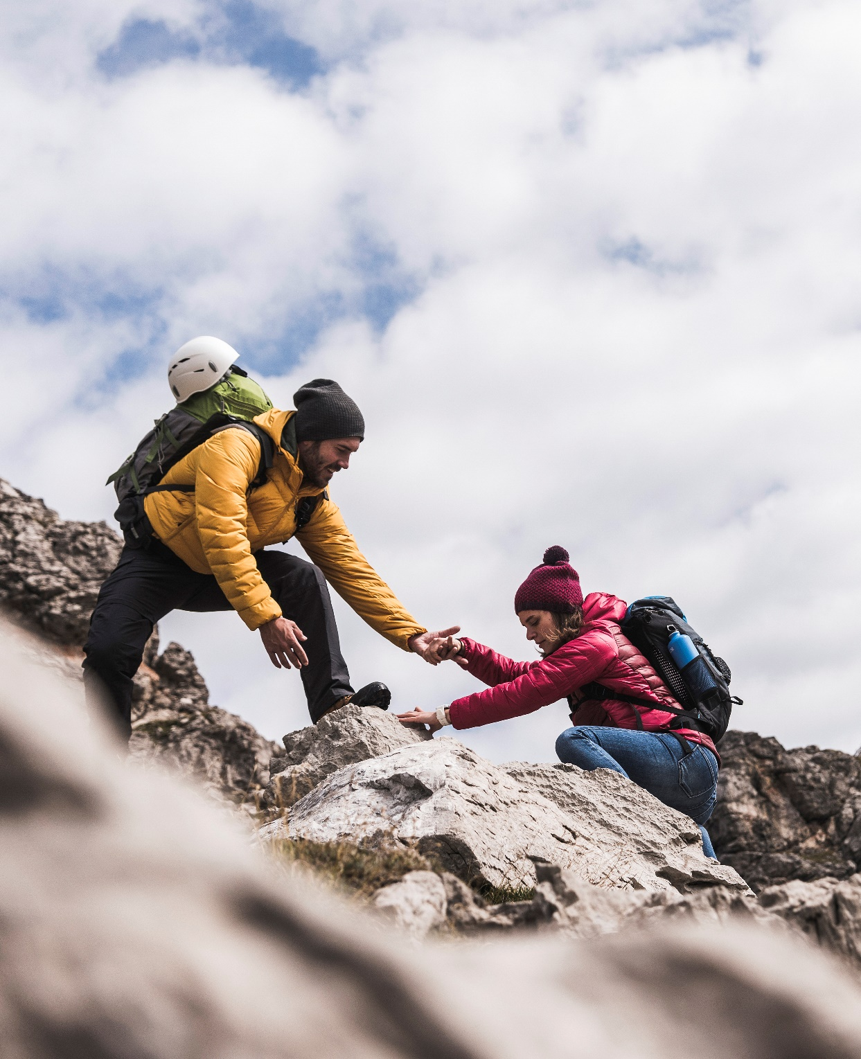
Thank You

